Slide 1

Milestone 1 : “Web crawling the real time data by using Python” WQD7005 (Data Mining) Prof. Dr. Teh Ying Wah
Group members name :
Sivanesan Pillai (WQD 170074)
Mathavan Chandrasegaram (WQD 170075)
Notes:
Be specific and direct in the title. Use the subtitle to give the specific context of the speech.
-The goal should be to capture the audience’s attention which can be done with a quote, a startling statistic, or fact. It is not necessary to include this attention getter on the slide.

Slide 2
INTRODUCTION
The internet is a pool of data and, with the right set of skills, one can use this data in a way to gain a lot of new information. You can always copy paste the data to your excel or CSV file but that is also time-consuming and expensive.
Web crawling, web scraping, web harvesting, or web data extraction is data scraping used for extracting data from websites.
BeautifulSoup is one popular library provided by Python to scrape data from the web. To get the best out of it, one needs only to have a basic knowledge of HTML.
Notes:
Dedicate this entire slide to the thesis statement. It is the reason the speech is being given. Use this time to reveal the three main points of the speech (slides 4,5,6) as an overview for the direction of the speech:
-[type main point #1 here]
-[type main point #2 here]
-[type main point #3 here]
Be sure to transition to the first main point and the next slide.

Slide 3
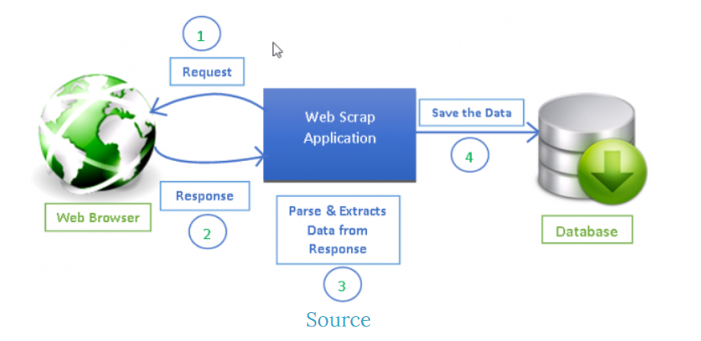
WEB CRAWLING OVERVIEW
Develop web crawlers with Scrapy, a powerful framework for extracting, processing, and storing web data.
Scrapy is a Python framework for web scraping that provides a complete package for developers without worrying about maintaining code.
Beautiful Soup is also widely used for web scraping. It is a Python package for parsing HTML and XML documents and extract data from them. It is available for Python 2.6+ and Python 3.
[use this space to place an image that best captures the main idea of point #1]
Notes:
The title of main point #1 should be clear and concise. Each piece of evidence should be summarized for clarity and cited correctly. Do not simply read the pieces of evidence, but elaborate where needed.
[type notes for elaboration here]
Be sure to transition to main point #2 and the next slide.

Slide 4
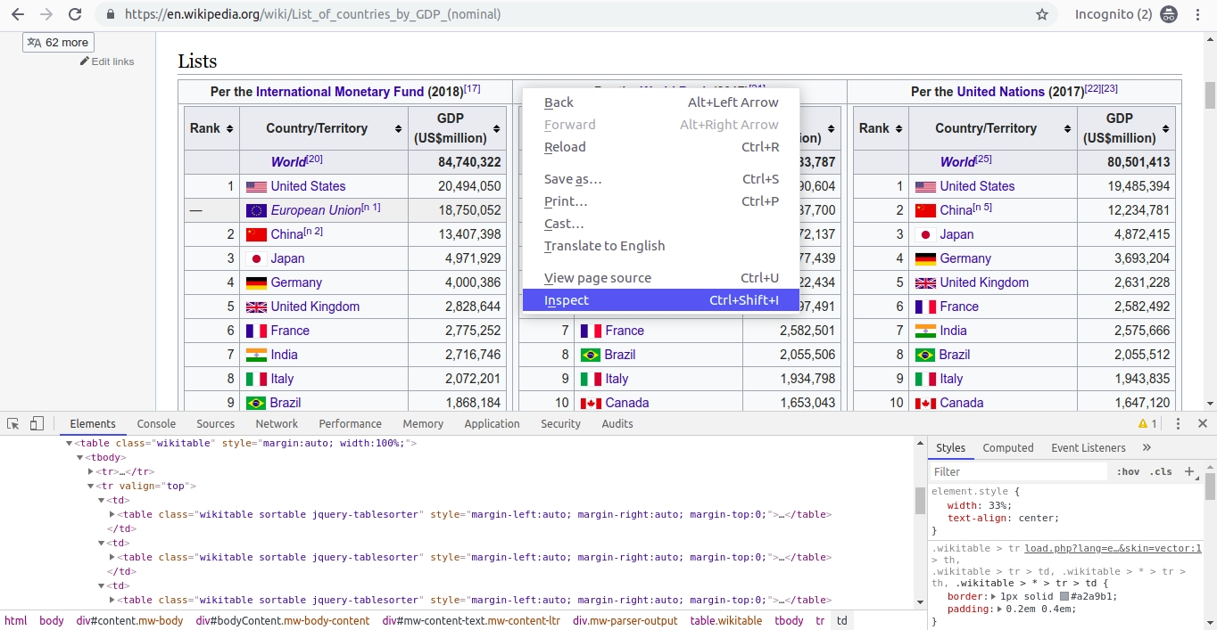
Understanding and Inspecting the Data
Inspection is the most important job in web crawling, without knowing the structure of the webpage, it is very hard to get the needed information.
For our Milestone 1, we use Wikipedia to crawl some of its table data from the page List of countries by GDP (nominal).
This page contains a Lists heading which contains three tables of countries sorted by their rank and its GDP value as per "International Monetary Fund", "World Bank", and "United Nations".
Note, that these three tables are enclosed in an outer table.
[use this space to place an image that best captures the main idea of point #2]
Notes:
The title of main point #2 should be clear and concise. Each piece of evidence should be summarized for clarity and cited correctly. Do not simply read the pieces of evidence, but elaborate where needed.
[type notes for elaboration here]
Be sure to transition to main point #3 and the next slide.

Slide 5
STEPS FOR CRAWLING WEBSITES
Sending an HTTP GET request to the URL of the webpage that you want to scrape, which will respond with HTML content. We can do this by using the Request library of Python.
Fetching and parsing the data using Beautifulsoup and maintain the data in some data structure such as Dict or List.
Analyzing the HTML tags and their attributes, such as class, id, and other HTML tag attributes. Also, identifying your HTML tags where your content lives.
Outputting the data in any file format such as CSV, XLSX, JSON, etc.
Notes:
Use the background points to post details that are not common knowledge, or that the audience will need to understand the context of the speech.
-Do not read these main points from the PowerPoint, instead elaborate on these points during the speech.

Slide 6
JUMP INTO THE CODE
# Step 1: Sending a HTTP request to a URL
# Step 2: Parse the html content
# Step 3: Analyze the HTML tag, where your content lives
# Create a data dictionary to store the data.
# Get the table having the class wikitable
# Get all the headings of Lists
# Get all the 3 tables contained in "gdp_table"
# Get all the rows of table
# Put the data for the table with his heading.
# Step 4: Export the data to csv

Slide 7
CONCLUSION
On this assignment (Milestone 1) we have went through the process of how to crawled a Wikipedia page using Python3 and Beautiful Soup and finally exporting it to a CSV file. We have learned how to crawl a basic website and fetch all the useful data in just a couple of minutes.
Thank you Prof. Dr. Teh Ying Wah.
Notes:
The counterargument should be the most common argument against the topic. The goal for this slide is to address the counterargument in such a way as to actually strengthen the original topic. Be sure to address each piece of evidence against the topic. As you address each piece of evidence elaborate on the text found on the slide. Remember to transition to the final slide, the action step.

